Slide 1
IS3120 Network Communications Infrastructure
Unit 3
TCP/IP Communication Protocols

Slide 2
Class Agenda 4/1/16
Learning Objectives
Lesson Presentation and Discussions.
Discussion on Assignments.
Discussion on Lab Activities.
Break Times as per School Regulations.
Quiz 1-Open book- Chapter 1 and 2

Slide 3
Learning Objective
Examine the TCP/IP protocol family and how IP is used to support voice, video, data and Internet communications.

Slide 4
Key Concepts
Connectionless (UDP) versus connection-oriented (TCP) communication
TCP/IP networking protocols and applications, such as ARP, DHCP, DNS, SNMP, and ICMP
Real-time communication protocols and services, such as VoIP, SIP, RTP, MPLS, and H.323
IP addressing: IPv4 versus IPv6
TCP/IP protocol capture and analysis

Slide 5
EXPLORE: CONCEPTS Network as a data communication system

Slide 6
OSI Reference Model
Transport
Network
Data Link
Physical
Application
Presentation
Session
Defines and abstracts network communications
Logical layers based on communication function
Hosts interact on same layer

Slide 7
OSI Model Layer Functionality
Application
Transport
Network
Data Link
Presentation
Session
Physical
Interacts with application software
Formats data for transmission
Manages connections between hosts
Transfers data between hosts
Handles addressing and routing
Transfers data on a local network
Physical hardware

Slide 8
TCP/IP Reference Model
Application
Transport
Internet
Network Access
Simpler than OSI Model
Layers correspond to TCP/IP protocol suite functionality
Messages move down stack, from 4 to 1

Slide 9
TCP/IP Model Layer Communications Scope
Application
Transport
Internet
Network Access
Between applications, processes
Between hosts
Between networks
Between a host and local network

Slide 10
OSI and TCP/IP Model Comparison
OSI Model
Application
TCP/IP Model
Application
Presentation
Session
Transport
Network
Data Link
Physical
Transport
Internet
Network Access

Slide 11
Relate Protocols to Networking Functions
Address Resolution Protocol (ARP)
Dynamic Host Configuration Protocol (DHCP)
Domain Name System (DNS)
Internet Control Message Protocol (ICMP)
Internet Protocol (IP)
Internet Protocol Security (IPSec)
Simple Network Management Protocol (SNMP)- Manage and monitor network elements
Notes:
The listed protocols will be examined on the following slides.
Each slide lists function and operating layer of the OSI Model

Slide 12
ARP
Transport
Network
Data Link
Physical
Application
Presentation
Session
Bridges Layer 3 and Layer 2
IP addresses into Media Access Control (MAC) addresses
Every network device has a unique MAC address
Reverse ARP (RARP) translates MAC addresses to IP addresses
Notes:
The instructor should note that ARP is not part of the TCP/IP protocol suite and does not use IP packets.
Sources differ about where ARP operates. It has been said to operate at Layer 2, Layer 3, and in between Layers 2 and 3. ARP was developed outside the OSI framework, so does not necessarily conform.
In TCP/IP networks, local area networks identify devices via MAC address
RFC 826: An Ethernet Address Resolution Protocol (http://tools.ietf.org/html/rfc826)
RFC 903: A Reverse Address Resolution Protocol (http://tools.ietf.org/html/rfc903)

Slide 13
DHCP
Transport
Network
Data Link
Physical
Application
Presentation
Session
Operates at Layer 7
Configures hosts on IP networks
Allocates host IP address
Provides IP addresses of service hosts
Notes:
RFC 2131 Dynamic Host Configuration Protocol (http://tools.ietf.org/html/rfc2131)
Instructor should note that allocation can be
Dynamic, in which hosts connecting to the network receive a free address out of a defined pool. This is referred to as “leasing” and when leases expire (based on DHCP server settings) these addresses can be returned to the pool for reallocation if the host is no longer connected to the network.
Static, in which hosts connecting to the network receive an assigned IP address based on their MAC address.

Slide 14
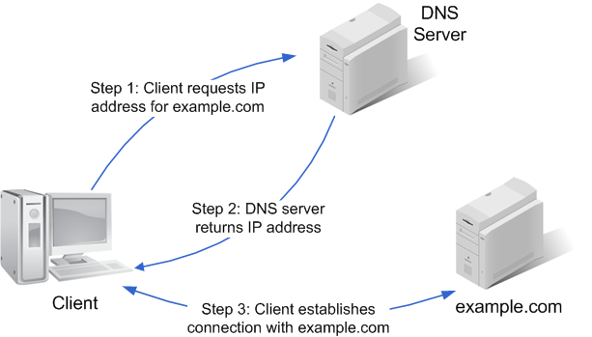
DNS
Transport
Network
Data Link
Physical
Application
Presentation
Session
Operates at Layer 7
Converts host names to IP addresses
Notes:
RFC 1034 Domain Names – Concepts and Facilities (http://tools.ietf.org/html/rfc1034)
RFC 1034 Domain Names – Implementation and Specification (http://tools.ietf.org/html/rfc1035)

Slide 15
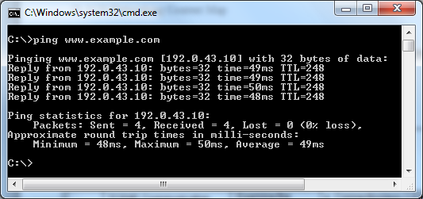
ICMP
Transport
Network
Data Link
Physical
Application
Presentation
Session
Operates at Layer 3
Queries and reports on status of devices and services
Notes:
RFC 792 Internet Control Message Protocol (http://tools.ietf.org/html/rfc792)

Slide 16
IP
Transport
Network
Data Link
Physical
Application
Presentation
Session
Operates at Layer 3
Routing and addressing
Packet routing services
Timeout (Time to Live [TTL])
Fragmentation of packets to improve throughput
Prioritization
Notes:
RFC 791 Internet Protocol (http://tools.ietf.org/html/rfc791)

Slide 17
IPSec
Transport
Network
Data Link
Physical
Application
Presentation
Session
Operates at Layer 3
Provides secure IP communications
Authentication
Encryption
Notes:
RFC 4301 Security Architecture for the Internet Protocol (http://tools.ietf.org/html/rfc4301)

Slide 18
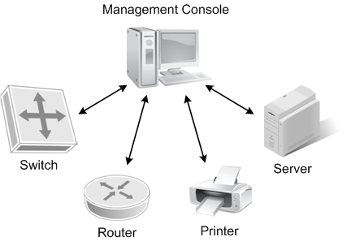
SNMP
Transport
Network
Data Link
Physical
Application
Presentation
Session
Operates at Layer 7
Manages and monitors networks from remote hosts
Notes:
RFC 2571 An Architecture for Describing SNMP Management Frameworks (http://www.ietf.org/rfc/rfc2571)
Instructor should note the difference between a “network application” and the “application layer”
A network application is a software program that uses a client-server architecture.
SNMP is a protocol used with network management applications.
The Application Layer interacts directly with software that utilizes network communication. Services include
Resource availability
Synchronizing communication
Identification and authentication of communication partners

Slide 19
EXPLORE: PROCESSES

Slide 20
VoIP
VoIP-Voice over Internet Protocol
The basic idea of VoIP is to put voice signal into a packet and transport them over Internet Protocol base network
VoIP started in 1995 by a small company in Israel called Vocaltee Inc

Slide 21
H323 Standards
H323- International Telecommunication Union’s (ITU) Protocol
Developed as a means to transmit voice, video, data and fax communication across IP based-network while maintaining connectivity with the PSTN

Slide 22
Session Initiation Protocol (SIP)
Developed by Internet Engineers Task force (IETF)
The Session Initiation Protocol (SIP) is an application layer signalling protocol
Uses well known port 5060 for communication.
Use to establish, maintain and terminate multimedia session or calls

Slide 23
Real Time Protocol (RTP)
RTP is used to transport media between endpoints
The H323 use the Real Time Protocol (RTP) for media communications

Slide 24
Multiprotocol Label Switching (MPLS)
Multiprotocol Label Switching (MPLS): speeds up and shapes network traffic flows.
MPLS allows most packets to be forwarded at Layer 2
Use to provide quality of service, improve latency and jitter

Slide 25
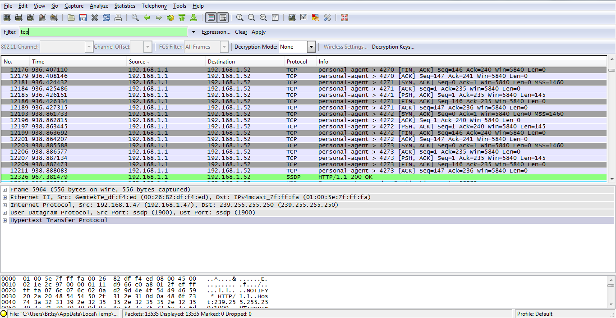
Packet Analyzer
Captures a real-time log (trace) of network communication
Can isolate transactions by protocol
Allows review of saved packet traces
Notes:
Instructor should draw attention to the difference between a Layer 2 switched network device (including switched hubs) and a Layer 1 hub in capturing packet traces (sniffing network traffic).
Hubs can be used in conjunction with promiscuous-mode network drivers to allow capture between two endpoint devices (computers A and B) external to the packet-capturing device (computer C). Lacking promiscuous-mode and connection to a hub or to the monitor port on a switched device, sniffing a TCP/IP network connection will only capture:
Packets sent from the network device itself
Unicast packets sent to its MAC address
Broadcast and unicast packets sent to its IP address
Multicast packets sent to the local network segment
Instructor should review the purpose and functions of a TCP/IP packet sniffer and traffic analyzer, noting that both functions can be combined as in the WireShark application that will be used in the lab. Although analysis can occur in real-time, the volume of data being captured can overwhelm systems resources for live analysis. Typically, a packet capture is performed and then analysis follows using a saved trace – to be covered later in this lesson.

Slide 26
Decoded Trace Information
Source
Source IP address
Destination
Destination IP address
Protocol
TCP/UDP and service
Port
Source and destination ports
Frame
Frames within transactions
Payload
Packet data payload
Notes:
Individual packet entries in WireShark are decoded to reveal details such as endpoint addresses and ports, protocols in use, frames within multi-packet communications, and individual packet data payloads. Discuss the use of non-standard ports when an attacker wishes to conceal their activity, such as by running an FTP server on port 16000. Note that protocol analyzers can group related frames from the same network transaction during analysis, although this can slow real-time data analysis.

Slide 27
Packet Capture Process
Start Capture
Network Operations
Stop Capture
Save Trace
Perform Analysis
Once WireShark is loaded, start capture
Perform network operations (ex: ping, FTP, telnet)
Stop packet capture
Save packet trace
Perform analysis
Notes:
Instructor should discuss order of operations, including the need to load the capture application (WireShark here) and initiate the capture. Data transfer prior to and after the capture session will not be available for packet capture and review. It is worth noting that extended periods of monitoring can generate huge volumes of data, much of it “spam” due to the logging of normal inter-device and inter-service communications.
Limiting packet traces using filters should be mentioned, noting that anything excluded from the packet trace by filters during capture will be unavailable later, while filters used during analysis can be turned on or off as desired to highlight or identify different actions. This will be used in the lab to identify transactions by protocol.
Traces should be saved to prevent accidental loss through WireShark closure or crash, or by starting a new capture which can overwrite a previous unsaved trace.
The instructor should note that packet capture and trace analysis can be performed concurrently, but are generally performed separately using previously-captured traces for analysis. Students should be reminded that filters applied during capture limit the packets available for trace analysis, while filters applied later during analysis are only a mechanism to limit displayed packets to a subset of the whole for ease of review.

Slide 28
Packet Analysis Process
Open Trace
Select filter criteria
Save filtered trace
Repeat for each filter
Review trace statistics
Document findings
Open saved trace or use current data
Select protocol for filter
Save resulting trace
Repeat selecting filter criteria for each protocol of interest
Review trace statistics
Notes:
During the lab, the learners will be asked to identify and save filtered traces for each of the identified protocols (TCP, AR, CDP, DNS and DHCP) and will be guided to identify their own network operations during the packet capture (PING, TELNET, SSH, FTP, TFTP).

Slide 29
Role of Packet Analysis
Discover devices and create a network map
Troubleshoot network communications
Inventory services and device endpoints to establish network operational baselines
Identify attack sources and protocols used
Notes:
Instructor should engage learners to discuss both beneficial uses listed above and detrimental uses of packet sniffers. Examples for detrimental use include interception of unencrypted logon actions (example: FTP) and man-in-the-middle attacks intercepting and modifying data during transmission between endpoints.

Slide 30
Why Use TCP/IP?
TCP/IP protocols allow for the identification and directed communication between two devices or services both local or extended across the global Internet.
The TCP/IP family of protocols facilitate voice, video, data transfer, and Internet communications between devices located anywhere in the world.

Slide 31
Why Is Packet Capture and Trace Analysis Important for IT?
Packet capture and trace analysis comprise a valuable toolset for troubleshooting, analyzing and securing network resources across all technical domains of the typical IT infrastructure.
Knowledge of trace preparation and evaluation provides value to the learner and any enterprise employing networked computing devices.
Notes:
The instructor may wish to further engage learners by noting that the practices in this lesson also provide value to students in their upcoming lab assignment using WireShark in packet capture and analysis.

Slide 32
Summary
In this presentation, the following were covered:
The OSI and TCP/IP Reference Models
TCP/IP networking protocols and applications
Network packet analysis utilities
Procedures for network packet trace capture
Procedures for packet trace analysis by protocol

Slide 33
Assignments and Lab Activities
Discussion 3.1: Connectionless versus Connection-Oriented Communications
Lab 3.2 : TCP/IP Communication Protocols
Assignment 3.3 Convergence of IP Based Networks

