Slide 1
NT1210 Introduction to Networking
Unit 10
Chapter 10, TCP/IP Transport

Slide 2
Class Agenda 11/20/15
Learning Objectives
Final exam in the next class
Next class is on 11/30/15.
Make up day for holiday
Lesson Presentation and Discussions
Lab Activities will be performed in class.
Assignments will be given in class.
Break Times. 10 Minutes break in every 1 Hour.
Note: Submit all Assignment and labs due today.

Slide 3
Objectives
Use network tools to monitor protocols and traffic characteristics.
Define how data logically moves through networks.
Compare and contrast TCP and UDP transportation techniques.
3

Slide 4
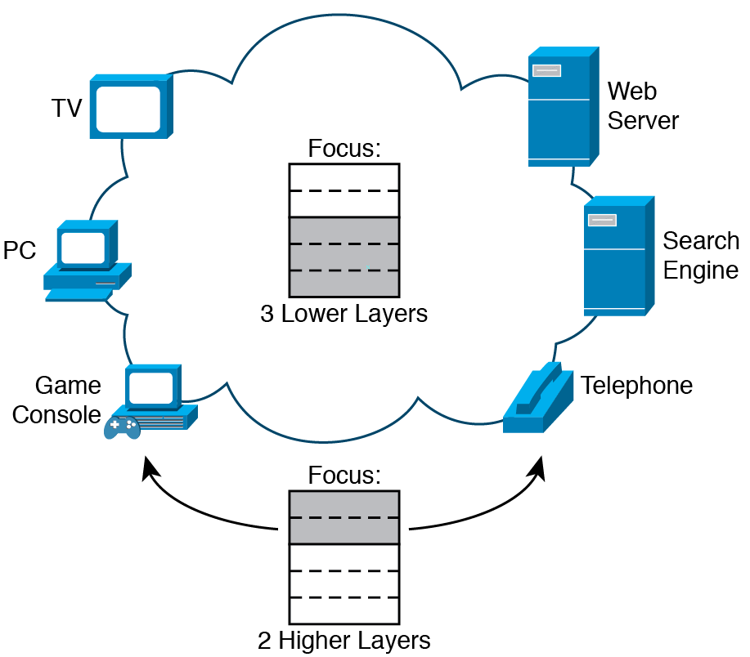
Transport and Application Protocols
Transport and Application Layers focus on hosts
Scope of Impact for TCP/IP Layers
4
Figure 10-1

Slide 5
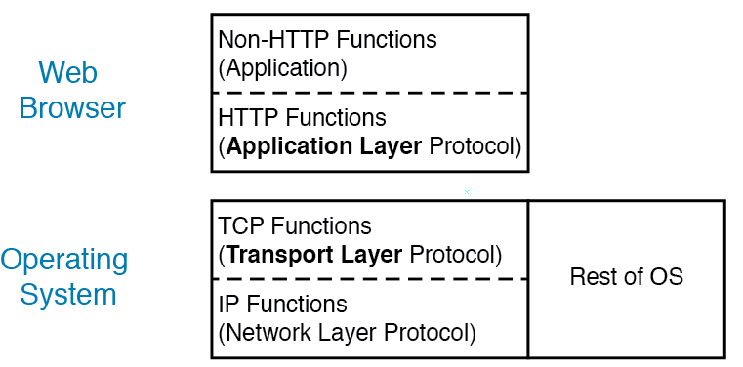
Transport and Application Protocols
Application developers include Application layer protocol in application (e.g., Telnet)
OS vendor includes Transport protocol inside OS (e.g., IE in Windows)
Software Architecture of Application and Transport Layers
5
Figure 10-2

Slide 6
Transport and Application Protocols
Encapsulation and headers: Application and Transport layer protocols use headers to do their work
Application protocol on sending host adds Application protocol header that destination host’s Application layer protocol reads
Transport layer adds headers based on protocol used: TCP or UDP
6

Slide 7
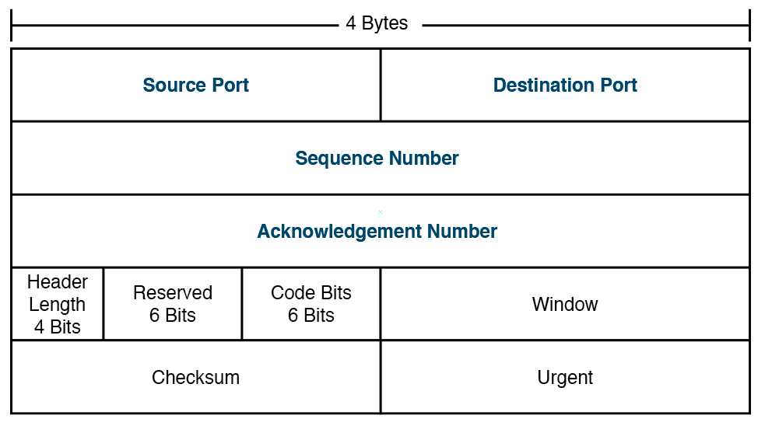
Transport and Application Protocols
UDP header format
TCP header format
UDP/TCP Header Reference
7
Figure 10-4,5

Slide 8
Transport and Application Protocols
Sending host adds original Application and Transport layer header to data to create message; upper layer messages remain mostly unchanged as they pass through network
Example: Message from web server going the web browser; message shows TCP, HTTP, Data Link, and IP headers plus data going through route from host to host
Encapsulation with Web Traffic, All Layers
8
Figure 10-6

Slide 9
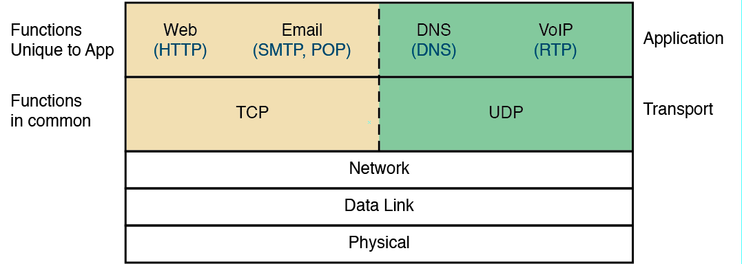
Transport and Application Protocols
Applications and their preferred Transport protocols
Some Applications Using TCP, and Some Using UDP
9
Figure 10-8

Slide 10
Transport Layer Concepts
Elements of Transport Protocols
Addressing
Connection Establishment
Connection Release
Flow Control and Buffering
Multiplexing
Crash Recovery
Needing and Supplying Services in TCP/IP Upper Layers
10
Figure 10-3

Slide 11
Transport Layer Concepts
TCP: Reliable, in-order delivery
Congestion control
Flow control
Connection setup
UDP: Unreliable, unordered delivery
No-frills, “best-effort” delivery
Delay guarantees
Bandwidth guarantees
Needing and Supplying Services in TCP/IP Upper Layers
11
Figure 10-3

Slide 12
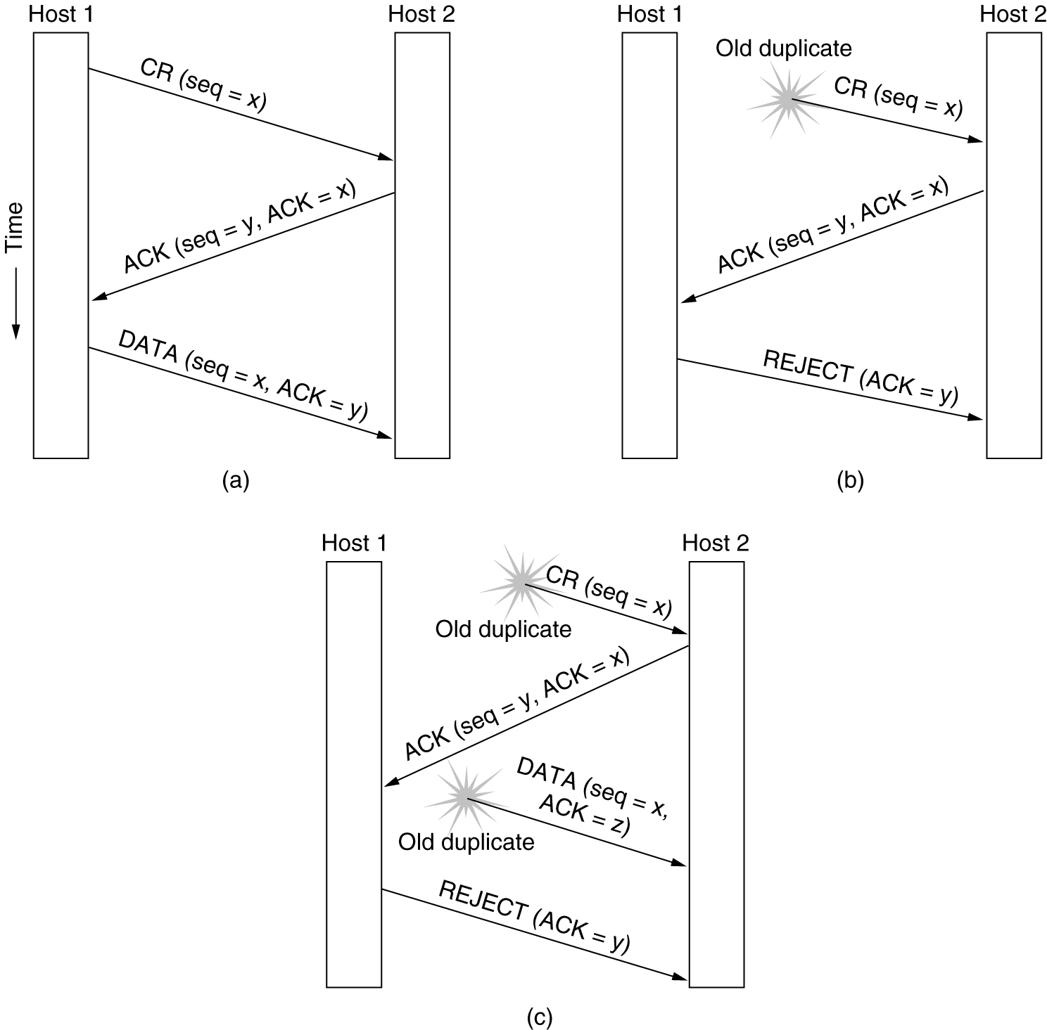
Transport Layer Concepts
Connection establishment using three-way handshake
CR = CONNECTION REQUEST
(a) Normal operation
(b) Old CONNECTION REQUEST appearing out of nowhere
(c) Duplicate CONNECTION REQUEST and duplicate ACK
12

Slide 13
Transport Layer Concepts
Connection release
(a) Normal case of three-way handshake release
(b) Error case: Final ACK lost
13

Slide 14
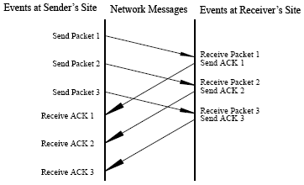
Transport Layer Concepts
Flow control: “Window” can dynamically resize
According to network conditions
According to sender’s capacity
According to receiver’s capacity
http://wiki.treck.com/File:Fig1.40_Using_a_Sliding_Window_Protocol.gif
14

Slide 15
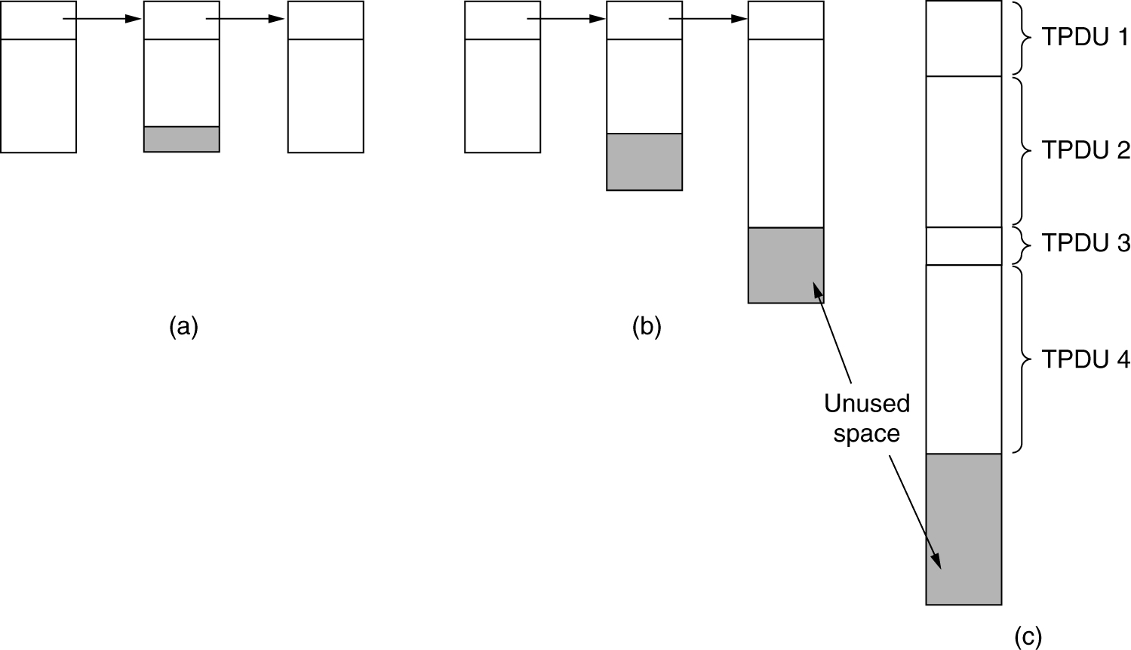
Transport Layer Concepts
Buffering
(a) Chained fixed- size buffers
(b) Chained variable-sized buffers.
(c) One large circular buffer per connection
15

Slide 16
Transport Layer Concepts
Multiplexing
Multiplexing at sender: Handles data from multiple sockets, adds transport header (later used for demultiplexing)
Demultiplexing at receiver: Uses header info to deliver received segments to correct socket
16

Slide 17
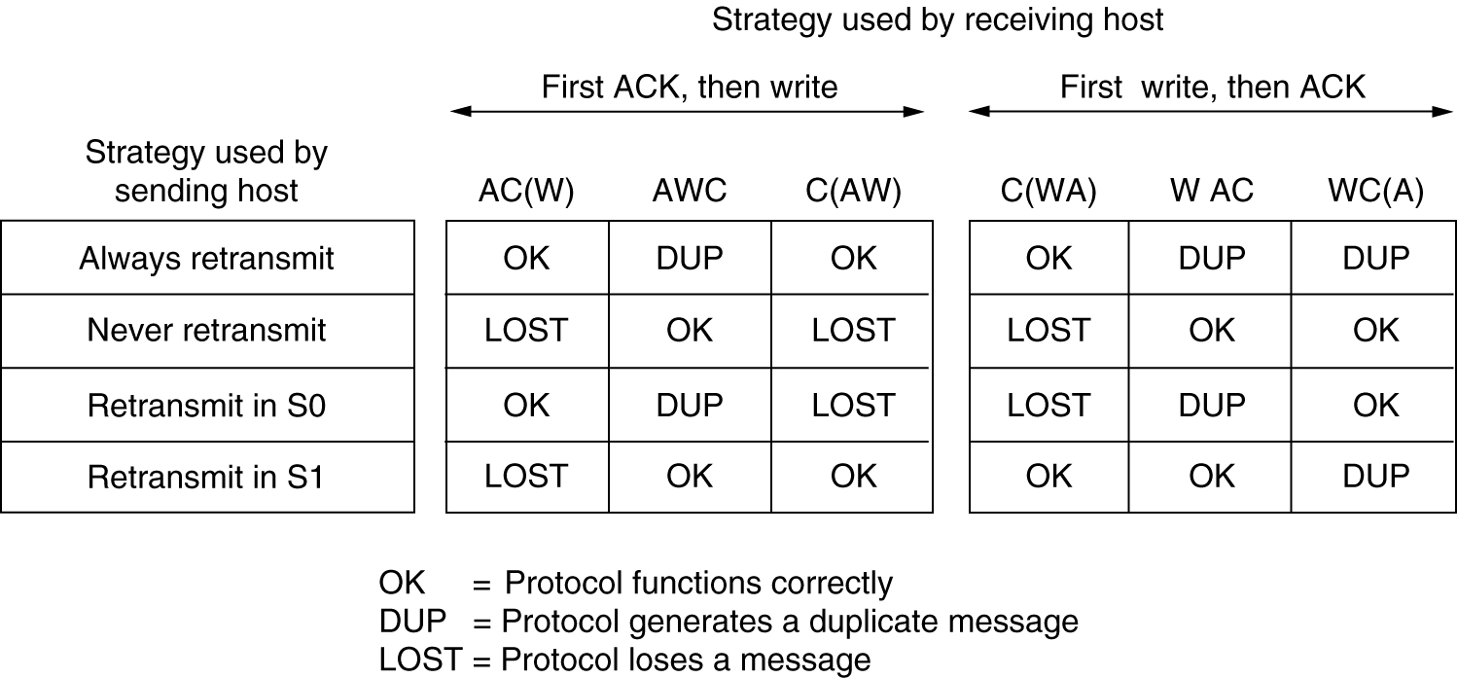
Transport Layer Concepts
Crash Recovery: Different combinations of client and server strategies
17

Slide 18
Short Break
Take 15
18

Slide 19
Transport Layer Port Numbers
Most host OSs allow multiprocessing which allows more than one program to be active at same time
Each active program gets share of CPU and RAM with all programs taking turns
Transport of data packets similar
Protocol identifies correct application process on destination host and uses port to identify communication session
Concept of Application-to-Application Flows Between Two Apps
19
Figure 10-9

Slide 20
Transport Layer Port Numbers
Port numbers identify application processes
Example: 3 TCP communication sessions with TCP port numbers; Both hosts are using TCP port 1024 so have to use different TCP port numbers to identify separate communication sessions
Three TCP Flows with Unique TCP Ports per Host
20
Figure 10-10

Slide 21
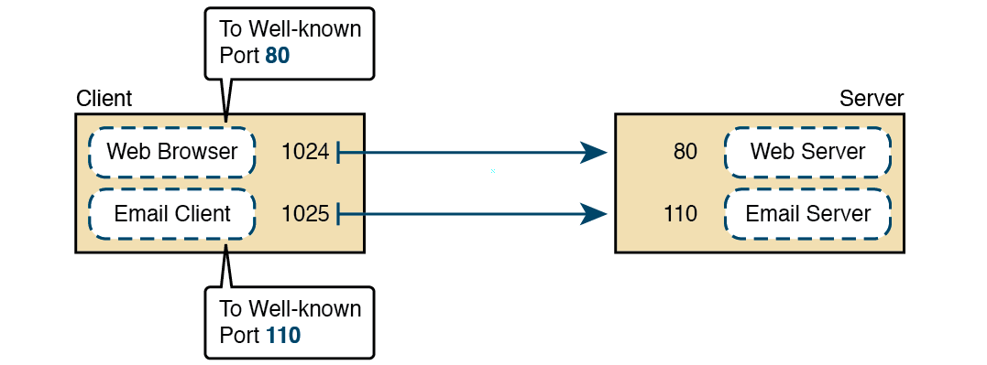
Transport Layer Port Numbers
Web browser software knows web servers should use port 80 by default
Email client software knows that POP3 servers use TCP port 110 by default
Clients Send TCP Segments to Correct Well-Known Port Numbers
21
Figure 10-14

Slide 22
Transport Layer Port Numbers
Application Protocol | Transport Protocol | Port Number | Description
HTTP | TCP | 80 | Used by web browsers and web servers
Telnet | TCP | 23 | Used for terminal emulation
SSH | TCP | 22 | Used for secure terminal emulation
FTP | TCP | 20, 21 | Used for file transfer
DNS | UDP | 53 | Used for name-to-IP resolution
SMTP | TCP | 25 | Used to send Email
POP3 | TCP | 110 | Used to receive Email
IMAP | TCP | 143 | Used to receive Email
SSL | TCP | 443 | Used to encrypt data for secure transactions
SNMP | UDP | 161, 162 | Used to manage TCP/IP networks
Common Application Protocols and Their Well-known Port Numbers
22
Table 10-1
Notes:
Common TCP/IP Application protocols, Transport protocol used and well known port numbers

Slide 23
Transport Layer Port Numbers
IANA regulates range of numbers for well known ports, dynamic ports, and registered ports
Ranges apply to both TCP and UDP
Type | Port Number Range
Well-known | 0 - 1023
Registered | 1,024 – 49,151
Dynamic | 49,153 – 65,535
Well-known, Registered, and Dynamic Port Numbers
23
Table 10-2

Slide 24
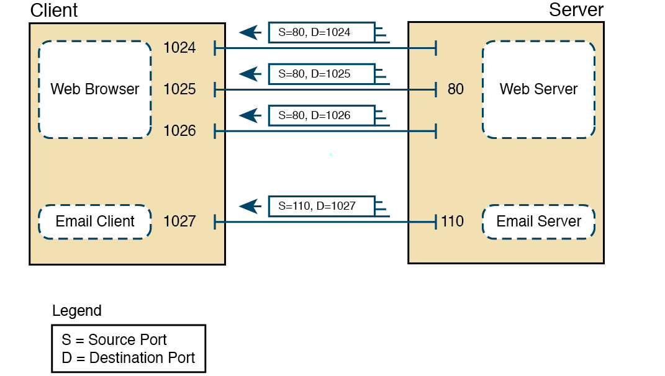
Transport Layer Port Numbers
Four returning messages with their respective port numbers
Port Numbers Reversed for TCP Segments in the Opposite Direction
24
Figure 10-19

Slide 25
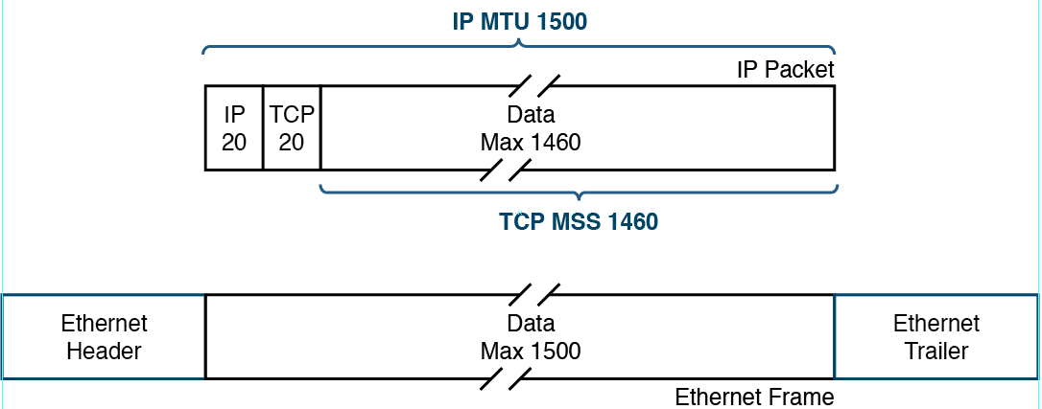
Other Transport Functions: Segmentation
Packets restricted for size in TCP/IP network so use segmentation to break large data packages into smaller pieces
Maximum Transmission Unit (MTU): Maximum size of IP packet that can be sent out network device interface (e.g., router)
Based on interface’s Data Link protocol; example: Ethernet has MTU of 1500 bytes for TCP
IP MTU Concept on Ethernet Links
25
Figure 10-20

Slide 26
Other Transport Functions: Connection Management
TCP guarantees delivery and has error recovery built in (connection-oriented)
To confirm destination received data, TCP uses acknowledgments for each segment received with no errors
Example: Web server sends three TCP segments to web browser with sequence numbers (SEQ); client sends message back to server (ACK) stating all three segments received and to send next set of segments
26

Slide 27
Other Transport Functions: Connection Management
Three-way handshake
client state
server state
LISTEN
LISTEN
choose init seq num, x
send TCP SYN msg
SYNSENT
SYNbit=1, Seq=x
choose init seq num, y
send TCP SYNACK
msg, acking SYN
SYN RCVD
SYNbit=1, Seq=y
ACKbit=1; ACKnum=x+1
received SYNACK(x)
indicates server is live;
send ACK for SYNACK;
this segment may contain
client-to-server data
ESTAB
ACKbit=1, ACKnum=y+1
received ACK(y)
indicates client is live
ESTAB
27

Slide 28
Other Transport Functions: Connection Management
Congestion control: Too many sources sending too much data too fast for network to handle
Different from flow control!
Manifestations
Lost packets (buffer overflow at routers)
Long delays (queuing in router buffers)
28

Slide 29
Other Transport Functions: Connection Management
UDP: Connectionless protocol
Does not use acknowledgements
Does not use sequencing
Will not retransmit missing datagrams
Considered less reliable than TCP
Has much less overhead than TCP
Much faster than TCP
29

Slide 30
Other Transport Functions: Error Recovery
TCP error recovery uses SEQ and ACK packets
Data sent from source in TCP segments with sequence numbers
Source expects to receive ACK from destination with next sequence number
If source does not receive ACK with expected value or receives no ACK at all in reasonable time, retransmits TCP segments
30

Slide 31
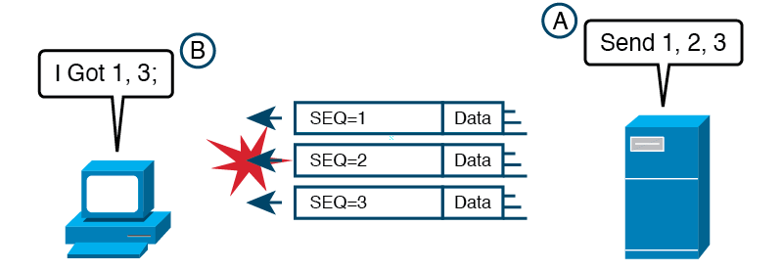
Other Transport Functions: Error Recovery
When receiving host gets some, but not all segments, can send back ACK but with value that tells sender to retransmit some data
Example: Second TCP segment has bit errors that occurred during its trip through network so destination router discards TCP segment
An Example with an Error; the Recovery Happens Later
31
Figure 10-24
Notes:
In this example, The server sent 1, 2, and 3, but it gets a TCP segment with ACK=2.
The server, knowing that the client’s ACK=2 means that the client did not receive the segment with sequence number 2.
The server starts resending segments starting with segment 2, as shown in the figure.
Following the steps in the figure:
The client (on the left) sends back a TCP segment, ACK=2, meaning that a) the client received the segment with SEQ=1, b) the client did not receive the TCP segment with SEQ=2.
The server (on the right) chooses to resend the segment that the client had not yet received, the TCP segment with SEQ=2.
The client now has both the segment with SEQ=2 and SEQ=3, so the client confirms that it has both, with a segment showing ACK=4

Slide 32
Comparing TCP and UDP
TCP RFCs: 793,1122,1323, 2018, 2581
Point-to-point: One sender, one receiver
Reliable, in-order byte steam: No “message boundaries”
Pipelined: TCP congestion and flow control set window size
Full duplex data
Bi-directional data flow in same connection
MSS: Maximum segment size
Connection-oriented: Uses handshaking
Flow controlled: Sender will not overwhelm receiver
32

Slide 33
Comparing TCP and UDP
UDP does NOT guaranteed delivery (connectionless) so Application protocols that do not need guaranteed delivery use UDP
Gives Application protocol designers option for less overhead
UDP header smaller than TCP headers
UDP also faster as it does not stop and wait for acknowledgements of delivery
33

Slide 34
Comparing TCP and UDP
Common features
Both connect applications
Both provide service so application can send data to correct application on destination host
Both use port numbers in their headers
Differences
TCP has more functions, but slower because of them
UDP faster due to less overhead, but fewer functions including no error recovery
34

Slide 35
Comparing TCP and UDP
Feature | TCP | UDP
Delivering data between two applications | Yes | Yes
Identifying servers using well-known ports | Yes | Yes
Segmenting data | Yes | No
Guaranteed delivery through error recovery | Yes | No
In-order delivery | Yes | No
Flow control | Yes | No
TCP and UDP Comparisons
35
Table 10-3

Slide 36
Summary, This Chapter…
Explained the relationship between network applications, application protocols, and transport protocols.
Gave examples of where Application and Transport layer protocols are implemented in a typical TCP/IP host.
Sketched the concept of an application flow occurring over a TCP/IP network.
Explained why servers often use well-known ports.
Gave examples of TCP flows using port numbers, listing the source and destination ports used.
36

Slide 37
Summary, This Chapter…
Explained why clients often use dynamic ports.
Sketched the concepts of IP MTU and TCP MSS and their relationship.
Explained how a sending TCP host segments data.
Described the basics of how TCP acknowledges data and performs error recovery.
37

Slide 38
Questions? Comments?
38

Slide 39
Unit 10 Assignment
Complete chapter 10 multiple-choice
questions.
2. Complete the Define Key Terms table.
3. Read all chapters for exams

Slide 40
Unit 10 Lab
Complete all Labs in Chapter 9 of the lab book.
Lab should be completed in class.
Uncompleted Lab must be submitted in the next class.

