Slide 1
Class Agenda 1
Learning Objectives
Discussion of Project
Lesson Presentation and Discussions.
Discussion on Assignments.
Discussion on Lab Activities.
Break Times. 10 Minutes break in every 1 Hour.
Note: Submit all Assignment and labs due today.

Slide 2
Class Agenda 2
Theory: 6:00pm -8:00pm
Lab: 8:15pm to 11:00pm

Slide 3
Class Agenda 1
Learning Objectives
Discussion of Project
Lesson Presentation and Discussions.
Discussion on Assignments.
Discussion on Lab Activities.
Break Times. 10 Minutes break in every 1 Hour.
Note: Submit all Assignment and labs due today.

Slide 4
Class Agenda 2
Theory: 6:00pm -8:00pm
Lab: 8:15pm to 11:00pm

Slide 5
IS3220 Information Technology Infrastructure Security
Unit 5
Firewall Fundamentals

Slide 6
Learning Objective and Key Concepts
Learning Objectives
Describe the fundamental functions performed by firewalls
Key Concepts
IP stateful firewalls
Types, features, and functions of firewalls
Software-based and hardware-based firewall solutions
Filtering and port control strategies and functions
Homed firewalls and placement

Slide 7
EXPLORE: CONCEPTS

Slide 8
What Is a Firewall?
A network traffic control device or service
Enforces network security policy
Protects the network against external attacks
Establishes control over network traffic
Prevents connections from unauthorized sources to protected network systems, services, and resources
Firewall can be a software on a server, software on a workstation or may be a specialized hardware appliance.

Slide 9
Firewall
Typically used to filter packets
Sometimes called a packet filter
Designed to prevent malicious packets from entering the network
A firewall can be software-based or hardware-based
Hardware firewalls usually are located outside the network security perimeter
As the first line of defense

Slide 10
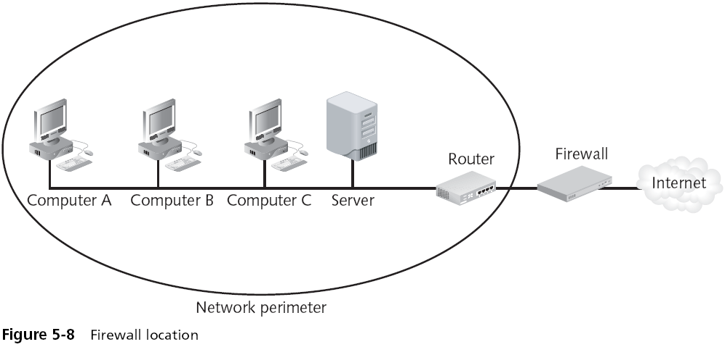
Firewall (continued)

Slide 11
Types of Firewalls
Packet Filtering
Multi-Homed
Screening
Stateless
Stateful
Application Proxy

Slide 12
Type of Firewalls.
Packet Filtering-Make access decision based on protocol header values
First generation of firewalls. Built into majority of firewalls
Stateful firewalls. Like a nosy neighbor, it keep track of connection and inspect communications by using state table.
Stateful Firewall can be a victim of DoS attack
Proxy Firewall act like a middleman and stands between trusted and untrusted network.

Slide 13
Firewall Architecture.
Firewall Architecture specifies where firewall are placed on the network
Multi-Homed :Devices are devices with many NIC that are used to connect different networks.
The devices most of the time used to hose a Firewall Software.
Common example is the DMZ
Screened Host: Firewall that communicate directly with perimeter router and internal firewall.
Screened subnet: External firewall which screen the traffic entering the DMZ

Slide 14
Descriptions of Firewalls
May be for personal or commercial use
Software or hardware based
May use dynamic or static packet filtering

Slide 15
Stateless Inspection
Maintain no “state tables” for active connections
Frames are treated individually rather than collectively
Filtering decisions are based on static addresses and port numbers
Notes:
Stateless firewalls maintain no “state tables” for active connections.
Unaware of session stream details for connection-oriented protocols
Frames are treated individually rather than collectively.
Cannot distinguish between packets in ongoing connections and rogue packets
Filtering decisions are based on static addresses and port numbers.
Pass (allow) or block (deny) traffic based on well-known connection values

Slide 16
Stateful Inspection
Maintain records of active connections
Pass (allow) and block (deny) decisions based on packets belonging to legitimate connection streams
Looks for packets that do not belong to authorized sessions
Advanced stateful firewalls track session endpoints
Retain additional state details, such as acknowledgement numbers and sequence numbers
Connectionless traffic is not “stateful” and therefore firewall state management does not apply
Notes:
Stateful firewalls maintain records of active connections to determine whether or not packets are part of existing sessions.
Pass (allow) and block (deny) decisions are based on packets belonging to legitimate connection streams.
Once a session is established, the firewall looks for packets that do not belong to authorized sessions.
Advanced stateful firewalls track session endpoints and retain additional state details, such as acknowledgement numbers and sequence numbers.
Connectionless traffic is not “stateful” and therefore firewall state management does not apply.

Slide 17
Advantages of Stateful Filtering
Keeping “state” observes network connections between points
Provide efficient packet inspection
Lack of “stateful record keeping” could result in breaking of legitimate connections
Notes:
Keeping “state” observes network connections between points
Most session-oriented protocols use random source ports.
State tracking adjusts and adapts to real-time traffic conditions.
State tracking watches end-to-end traffic streams, session-oriented start-up and tear-down.
State tracking treats packets collectively (start to finish) rather than individually.
State tracking has high operational overhead, robust rule configurations
Stateful firewalls provide efficient packet inspection.
Existing connections are checked against state table.
Computationally-intensive firewall filter lookup are avoided
Lack of “stateful record keeping” could result in breaking of legitimate connections.
Arbitrary source ports to well-known service destinations get dropped.

Slide 18
EXPLORE: PROCESS

Slide 19
Firewall Filtering Types and Strategies
Ingress/egress filtering
Packet filtering examines network protocol headers and parameters
Content filtering focuses on network protocol payloads
Notes:
Ingress/egress filtering
Monitoring and filtering directional inbound and outbound traffic
Packet filtering examines network protocol headers and parameters.
Static packet filtering (stateless) uses a fixed set of rules to filter network traffic.
Dynamic packet filtering (stateful) watches connection states to filter traffic.
Operates at the lowest OSI protocol layers
Content filtering focuses on network protocol payloads.
Intercepts and investigates packet content before it enters or leaves the network.
Concentrates on domain names, URLs, file names and extensions.
Administratively block unauthorized download resources and Web sites.
Operates at the higher OSI protocol layers

Slide 20
Firewall Filtering Types and Strategies
Stateful multi-layer inspection
Stateful and stateless inspection
Proxy servers respond to connection requests between clients and servers
Network Address Translation (NAT)
Notes:
Stateful multi-layer inspection
Inspects packet headers and payloads
Offers complete view of the entire seven-layer OSI protocol stack
Examines setup, state, and teardown of connection-oriented protocols
Stateful and stateless inspection
Tracking connection states to separate legitimate from questionable traffic
Proxy servers respond to connection requests between clients and servers.
Separates and isolates external and internal network endpoints
Circuit proxy (circuit-level firewall) monitor TCP handshakes to track sessions.
Application proxy filters by protocol content to enforce safe application behavior.
Network address translation (NAT)
Separates and isolates external and internal network endpoints
Maps several internal addresses to a common external address

Slide 21
EXPLORE: ROLES

Slide 22
Static and Dynamic Packet Filters
Static filtering is constant and unchanging
Dynamic filtering adapts to live traffic
Learns which ports are needed for a session
Blocks all others
Notes:
Static filtering is constant and unchanging.
Connection values—address, port, and protocol—are known in advance.
Connections must use well-defined ports and protocols.
Sessions are not observed start-to-finish between endpoints.
Dynamic filtering adapts to live traffic by learning which ports are needed for a session and blocks all others.
Firewall monitors inbound connection requests.
Legitimate requests are tracked from start to finish.
When session ends, the firewall closes the ports.

Slide 23
Application Gateway Overview
An application proxy, or application gateway, is like a packet filter but focuses more deeply on application protocol behaviors
Acts as middleman between client and server
Firewall and proxy combination achieves defense-in-depth strategy

Slide 24
Application Gateway Defense-in-Depth
Firewall and proxy combination achieves defense-in-depth strategy
Application proxies filter on content in the application layer payload
Network firewalls filter on lower-level protocol properties

Slide 25
Network Circuit Proxy
A circuit proxy or circuit-level firewall filters on connection-oriented startup
Observes initial setup of a circuit, session, or state
Once connected, a circuit is no longer filtered traffic

Slide 26
Circuit Proxy Filtering Rules
Circuit proxy filtering rules are similar to static packet filtering
Static values determine what circuits and connections are allowed
Filters can be set to default deny or default allow
Generally faster than application-layer firewalls due to fewer packet evaluations
Useful for connection-oriented protocols that perform TCP/IP handshakes

Slide 27
Network Address Translation (NAT)
NAT translates internal addresses to external addresses
NAT creates one-to-many mappings to extend IP address class availability and share a common Internet connection among several “hidden” hosts
NAT allows you to bypass individual IP assignments from an ISP
NAT conceals internal machines from the external world
Notes:
NAT translates internal addresses to external addresses.
NAT creates one-to-many mappings to extend IP address class availability and share a common Internet connection among several “hidden” hosts.
NAT allows you to bypass individual IP assignments from an ISP.
Create choke points through which all traffic must pass.
Reduce cost by using a single Internet IP among several internal computers.
Extend “full” IP address class ranges to smaller, separate network segments.
NAT conceals internal machines from the external world.
Keep private systems hidden from external access or view.
Let multiple internal connections appear to originate from one external system.

Slide 28
EXPLORE: RATIONALE

Slide 29
Software Firewalls
Software firewalls are installed on host computers
Built-in Windows Firewall or Linux packet filter
Competes for shared resources on the host computer
Static placement filters only connections made from/to the host
Protect only one system on the network, unless forwarding IP traffic

Slide 30
Hardware Firewalls
Hardware firewalls are installed on dedicated devices
Firewall appliances and dedicated routers with firewall services
Strategic placement throughout the network filters end-to-end connections
Stand-alone unit can protect multiple systems on the network
Optimized for network performance

Slide 31
Combination
Achieve defense-in-depth by combining hardware and software firewalls
Layered protection at the network and host levels by separate firewalls
Especially practical for mobile employees that telecommute to work

Slide 32
Host-Based Firewalls
Host-based firewalls protect only the local computer
Filters traffic passing through the local system only
Can filter traffic for other systems, such as Windows Internet Connection Sharing
Host-based “personal” software firewalls
Not optimized for firewall filtering

Slide 33
Network-Based Firewalls
Network-based firewalls span an entire network.
Filters all traffic passing in and out of the network or network segment
Can filter between other networks and systems
Commercial or corporate firewalls
Optimized for network-wide firewall filtering
Incorporate enterprise-grade network services
VPN
Enterprise-class encryption protocols
Enterprise-class security services

Slide 34
Single-Homed Firewalls
Single-homed firewalls have only one network interface
No physical isolation between internal and external networks
Ideal separation between host and network
Cannot provide sentry services between network segments

Slide 35
Multi-Homed Firewalls
Multi-homed means more than one network interface
Dual- or triple-homed
Filter local traffic on an internal network interface
Filter remote traffic on an external network interface
Filter traffic between internal and external interfaces
Create electronic isolations among segments, subnets, and networks
Ideal network separation with sentry services between networks

Slide 36
Reading Assignment
Chapter 5: Firewall Fundamentals

Slide 37
Unit 5 Assignments
Discussion 5.1 Ingress and Egress Filtering
Lab 5.2 Penetration Testing pfSense Firewall
Assignment 5.3 Select the Proper Type of Firewall

