Slide 1
Unit 9
ITT TECHNICAL INSTITUTE
NT1330
Client-Server Networking II
Date: 8/9/2016
Instructor: Williams Obinkyereh

Slide 2
Class Agenda 1
Learning Objectives
Lesson Presentation, Discussions and video.
Assignments and Lab Activities.
Break Times as per School regulation
Note: Submit all Assignment and labs due today.

Slide 3
Class Agenda 2
Theory : Unit 8:00pm-8:00pm)
Lab : (8:15pm to 11:00pm)
Text book for Unit 9:
Windows Server 2008 Active Directory Configuration MOAC 70-640-Lesson 9 and 10

Slide 4
Performing Software Installation with Group Policy, Planning Group Policy
Lesson 9 and 10

Slide 5
Objectives
Manage Software through Group Policy.
Install Software with Group Policy.
Manage Group Policy.
Filter Group Policy Scope.
Determine information needed to develop an implementation scenario.
Recommend an approach for installing software.

Slide 6
Managing Software through Group Policy
Group Policy can be used to install, upgrade, patch, or remove software applications .
Group Policy can be used to fix problems associated with applications.
For example, if a user inadvertently deletes a file from an application, Group Policy can be used to launch a repair process that will fix the application.

Slide 7
.MSI File
Microsoft Windows Server 2008 uses the Windows Installer with Group Policy to install and manage software that is packaged into an .msi file.
The Windows Installer Service, responsible for automating the installation and configuration of the designated software.
The Windows Installer Service requires a package file (.msi file) that contains all of the pertinent information about the software.

Slide 8
MSI File
The .msi file:
Is a relational database file that is copied to the target computer system with the program files it deploys.
Assists in the self-healing process for damaged applications and clean application removal.
Consists of external source files that may be required for the installation or removal of software.
Includes summary information about the software and the package.
Includes reference point to the path where the installation files are located.

Slide 9
.MST File
You may need to modify Windows Installer files to better suit the needs of your corporate network.
Modifications to .msi files require transform files, which have an .mst extension.

Slide 10
Patch file (.msp)
Windows Installer files with the .msp extension serve as patch files.
Patch files are used to apply service packs and hot fixes to installed software.
For this reason, .msp files should be located in the same folder as the original .msi file when you want the patch to be applied as part of the Group Policy software installation. This allows the patch file to be applied to the original package or .msi file.

Slide 11
ZAP File
When repackaging an application is not an option and a Windows Installer file is not available, you can use a .zap file to publish an application.
A .zap file is a non–Windows Installer package that can be created in a text editor.
The disadvantages of creating .zap files are as follows:
They can be published, but not assigned.
Deployments require user intervention, instead of being fully unattended.
Local administrator permissions might be required to perform the installation.
They do not support custom installations or automatic repair.
They do not support the removal of applications that are no longer needed or applications that failed to install properly.

Slide 12
Software Distribution Point
Before deploying software using Group Policy, you must create a distribution share/Software distribution point.
Users who are affected by the Group Policy assignment should be assigned NTFS Read permission to the folder containing the application and package files.

Slide 13
Assigning and Publishing Software
Assigning Software
If you assign the program to a user, it is installed when the user logs on to the computer.
If you assign the program to a computer, it is installed when the computer starts, and it is available to all users who log on to the computer.
When a user first runs the program, the installation is finalized.
Publishing Software
You can publish a program distribution to users.
When the user logs on to the computer, the published program is displayed in the Add or Remove Programs dialog box, and it can be installed from there.

Slide 14
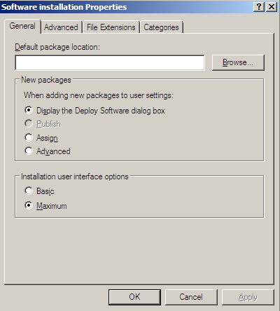
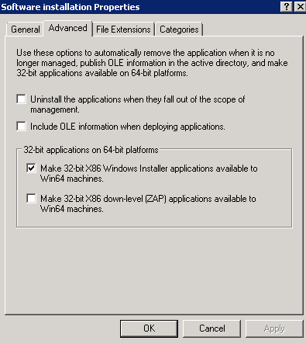
Assigning and Publishing Software
Notes:
Demonstrate this.

Slide 15
Software Restrictions Policies
Provide organizations greater control in preventing potentially dangerous applications from running.
Software restriction policies are designed to identify software and control its execution.
Administrators can control who will be affected by the policies.

Slide 16
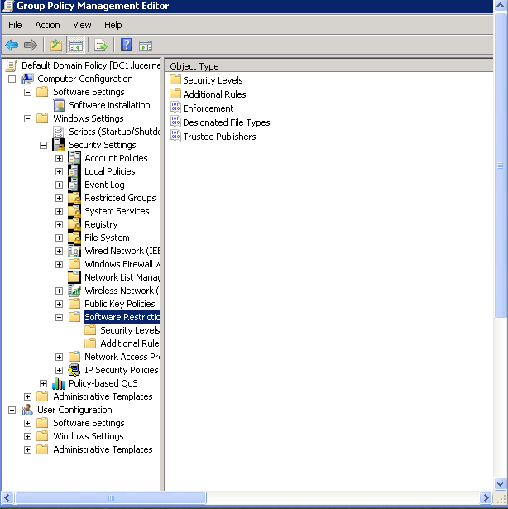
Software Restrictions Policies

Slide 17
Software Restrictions Policies
When considering the use of software restriction policies, you must determine your approach to enforcing restrictions.
The three basic strategies for enforcing restrictions are:
Unrestricted. This allows all applications to run except those that are specifically excluded.
Disallowed. This prevents all applications from running except those that are specifically allowed.
Basic User. This prevents any application from running that requires administrative rights, but allows programs to run that only require resources that are accessible by normal users.
By default, the Software Restriction Policies area has an Unrestricted value in the Default Security Level setting.

Slide 18
Software Restrictions Policies
Four types of software restriction rules can be used to govern which programs can or cannot run on your network:
Hash rule
Certificate rule
Path rule
Network zone rule

Slide 19
Group Policy Management Console
The Group Policy Management MMC snap-in is a tool for managing Windows Server 2008, Windows Server 2003, and Windows 2000 Active Directory domains.
.

Slide 20
Group Policy Management Console
Group Policy Management Console is used to:
Import and copy GPO settings to and from the file system.
Backup and restoration of GPOs is available in Group Policy Management.
Search for GPOs based on name, permissions,
Search for individual settings within a GPO by keyword

Slide 21
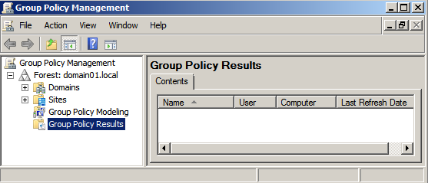
Group Policy Management Console

Slide 22
Managing an Individual GPO
The following features are available when a GPO is selected in the Group Policy Management interface:
Scope
Details
Settings
Delegation
Notes:
Demonstrate the GPMC again with all tabs.

Slide 23
Management interface
Scope: Allows administrators to view the locations to which the policy is linked.
Detail: Allows the GPO to be enabled or disabled.
Setting: When activated, an HTML report is generated that allows administrators to view GPO settings that do not have the original default values.
Delegation: Is used to delegate security in ACL

Slide 24
Settings
When this tab is activated, an HTML report is generated that allows administrators to view GPO settings that do not have the original default values.
Links on the right side of the report allow detailed information to be displayed or hidden.
Right-clicking within this view allows administrators to print or save the report.

Slide 25
Windows Management Instrumentation (WMI)
A component of the Microsoft Windows operating system that provides management information and control in an enterprise environment.
It allows administrators to create queries based on hardware, software, operating systems, and services.
These queries can be used to gather data or to determine where items, such as GPOs, will be applied.
WMI filters can be used to control which users or computers will be affected by a GPO based on defined criteria.
Notes:
You may also demonstrate clearing the WMI repository when the wmi gets corrupted. Disable the WMI service. Stop the WMI service. Go into the %windows\system32\wbem\ and delete the content inside the respository folder (not the folder itself). Re-enable and restart the WMI service. Repository. Content will automatically be recreated.

Slide 26
Unit 9 Assignments and Labs
Unit 9. Assignment 1. GPO Planning Scenario
Unit 9. Lab 1. Software Distribution and Controlling Group Policy
Unit 9. Exercise 1. Research Software Deployment Options

