Slide 1
IS3220 Information Technology Infrastructure Security
Unit 3
Network Security Threats
Chapter 4

Slide 2
Class Agenda 1
Learning Objectives
Discussion of Project
Lesson Presentation and Discussions.
Discussion on Assignments.
Discussion on Lab Activities.
Break Times. 10 Minutes break in every 1 Hour.
Note: Submit all Assignment and labs due today.

Slide 3
Class Agenda 2
Theory: Network Security Threats
( 6:00pm -8:00pm)
Lab: Network Discovery & Security Scanning Using ZenMap GUI (Nmap) (8:15pm to 11:00pm)

Slide 4
Reading
Stewart, Chapter 4. “Network Security Threats and Issues”
NIST SP 800-30: Risk Management Guide for Information Technology Systems (http://csrc.nist.gov/publications/nistpubs/800-30/sp800-30.pdf)
Other Website: CWE/SANS TOP 25 Most Dangerous Software Errors
https://www.sans.org/top25-software-errors/

Slide 5
Learning Objective
Recognize the impact that malicious exploits and attacks have on network security

Slide 6
Key Concepts
What are you protecting and from whom?
Intellectual property and privacy data
Risk assessment for network infrastructure
Wired and wireless network infrastructure risks, threats, and vulnerabilities
Common network hacking tools, applications, exploits, and attacks
Social engineering practices and their impact on network security efforts

Slide 7
EXPLORE: CONCEPTS

Slide 8
Malware ~ Malacious Code
Distribution Methods
Software downloads
E-mail
Malicious web sites
File transfer
Flaws in software
Effects of Malware
Data loss, exposure, or change
Poor system performance
Pop-up ads
System becomes a “bot” or “zombie”
Notes:
Also known as malicious code
Distributed by:
Software downloads
E-mail
Malicious Web sites
File transfer
Flaws in software
Effects of malware:
Data loss, exposure, or change
Poor system performance
Pop-up ads
System becomes a “bot” or “zombie” in control of the attacker

Slide 9
Common Types of Malware
Viruses and Worms
Trojan Horses
Keystroke Loggers (“keyloggers”)
Spyware and Adware
Rootkits
Logic Bombs
Trapdoors and Backdoors
URL Injectors and Browser Redirectors
Exploits

Slide 10
Malware: Viruses and Worms
Viruses
Infect boot sectors or files, such as executables, drivers, and system
Need user interaction to spread
Worms
Infect systems
Don’t need user interaction to spread
Can be carriers for other types of malicious code
Notes:
Viruses
Infect boot sectors or files, such as executables, drivers, and system
Need user interaction to spread
Spread file to file upon opening
May spread to other systems through e-mail or network shares
Worms
Infect systems
Don’t need user interaction to spread
Scan systems for flaws
Exploit flaws to infect other systems
Can be carriers for other types of malicious code

Slide 11
Malware: Trojan Horses
Delivery method for a malicious payload
Usually appear to be a benign program, such as a game or utility
Installed by users without knowledge of malicious payload
Allows remote access to attackers

Slide 12
Malware: Keystroke Loggers
Also called “keyloggers”
Software-based keyloggers can be installed via worms or Trojan horses
Record keystrokes and transmit them to the attacker
Hardware-based keyloggers
Notes:
Also called “keyloggers”
Software-based keyloggers can be installed via worms or Trojan horses
Record keystrokes and transmit them to the attacker
E-mail
FTP
Instant message
Hardware-based keyloggers
Inline with keyboard cable
In keyboard

Slide 13
Malware: Spyware and Adware
Spyware
Adware
May be bundled together
May be embedded in other programs
May masquerade as antimalware product
Notes:
Spyware
Monitors and records user activities, like keylogging software
Transmits information back to originating author
Adware
Similar to spyware
Delivers advertising through pop-ups, e-mail, or browser redirection
May be bundled together
May be embedded in other programs
May masquerade as antimalware products
Examples:
BonziBuddy
Gator/Gain Ad Server adware
Antivirus 2008

Slide 14
Malware: Rootkits
Codes that position themselves between the operating system kernel and hardware
Allows attacker to gain root/administrative access to system
Uses of rootkits
Notes:
Codes that position themselves between the operating system kernel and hardware.
Allows attacker to gain root/administrative access to system
Can be used to:
Take control of a system
Hide data files
Hide other malware or hacker tools

Slide 15
Malware: Logic Bombs
Malicious code that lies dormant until triggered
Triggering events
Time and date
Program launch
Keyword
Accessing a URL

Slide 16
Malware: Backdoors and Trapdoors
Synonyms for the same type of malware
Bypass normal authentication or security controls
Benefits to the attacker
Examples of backdoors and trapdoors
Notes:
Synonyms for the same type of malware
Bypass normal authentication or security controls
May allow attacker to:
Gain remote access to the system
Alter files and system settings
Install hidden software
Gain control of the system
Turn the system into a bot
Use the system to send spam
Examples:
Back Orifice – Early Microsoft Windows program designed for remote access and administration but also had malicious properties
Mydoom virus – Installs a back door on the infected computer

Slide 17
Malware: URL Injectors and Browser Redirection
Also called browser hijacking
Replace URLs with alternative addresses
Redirect browser to target Web sites
May also change browser home page
May prevent access to anti-malware Web sites
May inject entries into HOSTS file
Other malware may contain URL injector code

Slide 18
Malware: Exploits
Take advantage of flaws or bugs in software
Often embedded into other forms of malware
May be stand-alone or part of hacker toolkits
Notes:
Take advantage of flaws or bugs in software
Code bugs
Timing
Communication
Storage
Often embedded into other forms of malware
May be stand-alone or part of hacker toolkits

Slide 19
Impact of Malware on Organizations
Melissa Virus caused $80 million in damages in North America
SQL Slammer Virus
Code Red
Notes:
Melissa virus caused $80 million in damages in North America
SQL Slammer virus
$1 billion in damages
Bank of America ATMs unavailable
Continental Airlines flights delayed or canceled
Code Red
300,000+ computers infected
Denial of service
Cisco DSL routers stopped forwarding traffic
Sources:
Sophos http://www.sophos.com/pressoffice/news/articles/1999/12/va_melissa.html
CNET http://news.cnet.com/2009-1001-983540.html
CNET http://news.cnet.com/2100-1001-270314.html&tag=txt

Slide 20
Application Vulnerabilities
Buffer overflow
SQL Injection
Cross-site scripting (XSS)
Cached credentials
Notes:
Buffer overflow
Injection of more data than a memory buffer can hold
May result in arbitrary code execution
SQL Injection
Inserts code via unsanitized data input on Web sites
Allows access to back-end databases
Cross-site scripting (XSS)
Attackers insert client-side script into Web pages
Allows malicious scripts to be run in the user’s context
Cached credentials
Credentials stored on local machine, for example browser cache
Can be discovered by and reused by an attacker

Slide 21
Mitigating Application Vulnerabilities
In-House Coding
Operating systems or applications
Vulnerability scanning
Open Web Application Security Project (OWASP) for Web application security
Notes:
The instructor should include real-world examples based on professional experience.
For in-house coding:
Implement secure coding practices.
Include security in the software development life cycle.
Perform testing and quality control.
For operating systems or applications:
Keep abreast of vulnerabilities.
National Vulnerability Database (www.nvd.nst.gov)
US-CERT Vulnerability Notes Database (www.kb.cert.org/vuls/)
SecurityFocus (www.securityfocus.com/vulnerabilities)
Apply patches and updates in a timely manner.
Vulnerability scanning
Open Web Application Security Project (OWASP) for Web application security

Slide 22
Port Scanning
Mechanics | Uses
TCP or UDP packets are sent to ports on a system Scanning performed on single IP address or IP address range Open ports can verify: Indicators of open ports Noticeable and detectable | Useful to both hackers and security professionals Hackers Security Professionals
Notes:
When mentioning vulnerability scanning, stress the importance of conducting periodic vulnerability scans. Vulnerability scanning will be discussed in more detail in Unit 4.
Mechanics
TCP or UDP packets are sent to ports on a system
Scanning performed on single IP address or IP address range
Open ports can verify:
Particular services
Presence of a system
Indicators of open ports
TCP: Full TCP three-way handshake established
UDP: Lack of response may indicate open port since closed ports usually generate errors
Noticeable and detectable
Uses
Useful to both hackers and security professionals
Hackers
Determine existence of hosts
Determine existence of services
Security Professionals
Determine the existence of rogue hosts
Determine existence of rogue servers
Part of a vulnerability scan

Slide 23
EXPLORE: PROCESS

Slide 24
What is Risk?
Risk has several meanings
Danger
Consequences
Likelihood or probability
Definition of risk in formal risk assessment
Notes:
Risk has several meanings
Danger
Consequences
Likelihood or probability
Definition of risk in formal risk assessment
A measurement based on the relationship between likelihood and impact

Slide 25
Risk Assessment Methodology
Identification
Analysis
Determine risk for each threat-vulnerability pair
Prioritize mitigation efforts
Notes:
Identification
Identify assets.
Indentify threats.
Identify vulnerabilities.
Identify existing security controls.
Analysis
Identify threat-vulnerability pairs by matching threats with vulnerabilities to create exploit scenarios.
Analyze the effectiveness of existing controls.
Determine impact of a successful exploitation.
Determine likelihood of a successful exploitation.
Determine risk for each threat-vulnerability pair using a risk matrix.
Use the results to prioritize mitigation efforts.

Slide 26
Measuring Risk
Risk = Impact x Likelihood
Impact: The consequence of a successful exploitation of a vulnerability
Likelihood: How probable is it that an impact will occur?
Risk can be measured
Notes:
Risk = Impact x Likelihood
Impact: The consequence of a successful exploitation of a vulnerability
Financial
Reputation
Compliance
Likelihood: How likely is it that an impact will occur?
Risk can be measured
Qualitatively: Low, Moderate, High
Quantitatively: Numerical value
IT risk assessment is usually qualitative.
IT risk assessment is usually qualitative because it is difficult to obtain quantitative values
For qualitative vs quantitative the instructor may use insurance as an example. Insurance companies use actuarial data in order to quantitatively determine risk for the purpose of setting rates. For example, if one lives in an area prone to natural disaster, homeowner’s insurance rates will be higher than for one who does not. If one lives in a high crime area or has a make/model of car that is popular to steal, then auto insurance rates are higher than if one lives in a low crime area and has a vehicle unattractive to thieves. Insurance companies have access to actuarial data that allow them to put a number to likelihood and the impact is the financial loss of the property.
IT does not have the same type of actuarial data and it is difficult to put a dollar value on many of the impacts that can be caused by a successful security incident. Impact is often more than just financial loss – it can involve reputation, employee morale, customer satisfaction, or regulatory issues. It may also depend on the industry, the type of data, and where in the world the data is stored, processed, and transmitted. There are other qualitative components, such as what is important to management, that cannot be addressed in a quantitative risk assessment.

Slide 27
Risk Matrix
 |  | Likelihood
 |  | Low | Medium | High
Impact | Low | Low | Low | Medium
 | Medium | Low | Medium | High
 | High | Medium | High | Critical

Slide 28
EXPLORE: ROLES

Slide 29
The Hacking Process: Reconnaissance
Notes:
Web research
Search engines
Background checks
Newspaper searches
Press releases
Job openings
Social networking
Public records
Eavesdropping
Physical surveillance

Slide 30
The Hacking Process: Scanning
Notes:
War dialing
War driving
Netstumbling
Ping sweeps
Port scanning

Slide 31
The Hacking Process: Enumeration
Notes:
Discover target details
OS identification
Nmap
Service identification
Banner grabbing
Identify vulnerabilities

Slide 32
The Hacking Process: Attacking
Notes:
Exploit vulnerabilities
Network
Node
Application
Gain access

Slide 33
The Hacking Process: Post-Attack Activities
Notes:
Attack is successful
Escalate privilege
Install additional tools
Accomplish objective (e.g., data theft)
Remove evidence

Slide 34
The Hacking Process: Fall Back Attacks
Notes:
This slide segues into the other slides on various attacks
Intrusion attack fails
Attempt non-intrusion attack
Denial of service (DoS)
Eavesdropping
Breaking and entering
Malware
Session hijacking
Man-in-the-middle attacks
Web site attacks
SQL injection
Social engineering

Slide 35
Social Engineering Basics
“Hacking” people instead of systems
Conducing research or reconnaissance to identify appropriate targets
Communication methods
Manipulating targets
Notes:
When discussing financial gain, identify target assets such as credit card information, electronic funds, and trade secrets.
Personal motivations include challenge/thrill and curiosity.
Receptionists are common targets because they have a great deal of knowledge about individual employees, events, and scheduling. They also tend to be highly social and helpful.
Vulnerable employees include people with financial difficulties, emotional problems, or other issues that may make them susceptible to social engineering techniques.
“Hacking” people instead of systems
Conducing research or reconnaissance to identify appropriate targets
Receptionists
IT staff
Vulnerable employees
Communication methods include:
In person
Telephone
E-mail
Web sites
Goals include manipulating targets into:
Revealing information, including logon credentials
Downloading malware
Reconfiguring systems
Granting unauthorized physical access

Slide 36
Social Engineering Techniques
Methods for conducting research
Building relationships with targets then exploiting them
Impersonating
Reciprocity or a favor for a favor
Notes:
When discussing techniques, the instructor should provide a few examples from professional experience, but should remember the graded assignment for the Social Engineering Defense Issues discussion will require the students to identify specific ways a social engineer may attack an organization based on techniques.
Conducting research via:
Reconnaissance
Public information
Social networking sites
Dumpster diving
Cold calling
Building relationships with targets then exploiting them
Impersonating:
Authority figures, for example managers, executives, and police
Maintenance technicians
Vendors or clients
Employees
Tech support staff
Reciprocity or a favor for a favor

Slide 37
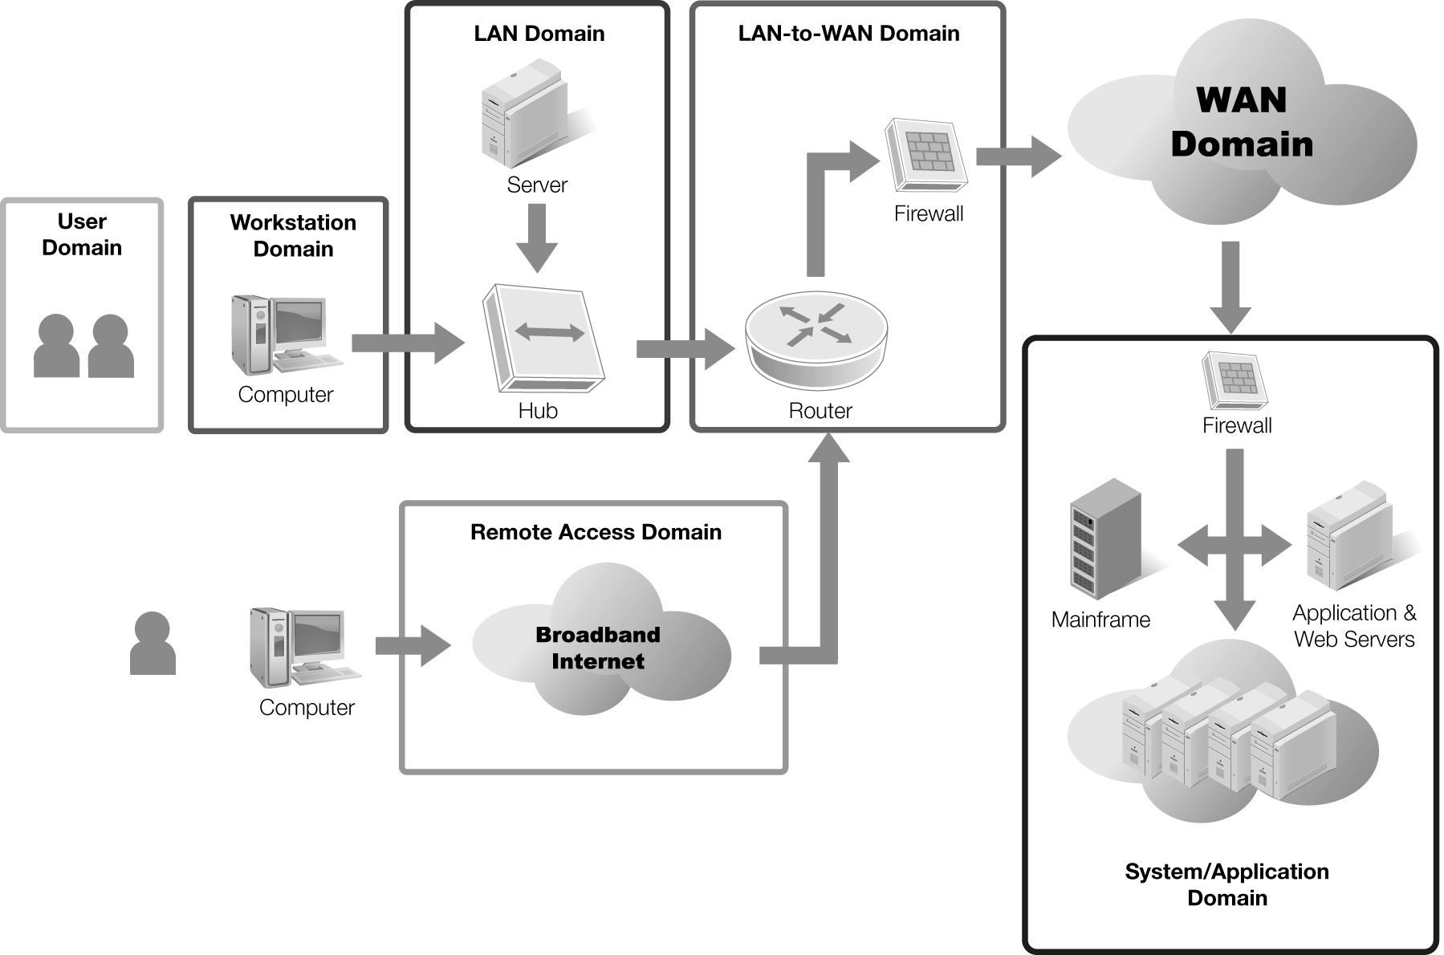
Seven Domains of a Typical IT Infrastructure

Slide 38
Definitions Review
Risk
Threat
Vulnerability
Notes:
Recap of definitions from Unit 2
Risk: Likelihood that a threat will exploit a vulnerability and the impact it will have on an organization
Threat: The possibility of an vulnerability being exploited
Vulnerability: Weakness in a process or system that has the potential to adversely impact confidentiality, availability, or integrity

Slide 39
Unit 3 Class Activities
Discussion 3.1: Social Engineering Defense Issues
Lab 3.2: Configuring a pfSense Firewall on the Client

