Slide 1
NT1110 Computer Structure and Logic
Unit 8 (Module 5A)
COMPUTER OPERATION AND SECURITY
Notes:
1

Slide 2
Class Agenda 7/29/16
Chapter 7 and 9
Learning Objectives
Discussion on Assignments and Lab.
Break Times as per School Regulations.
Assignment will be given in the next class
Reading Assignment.

Slide 3
Learning Objectives
To understnd
Basic Input/Output System (BIOS), Complementary Metal–Oxide–Semiconductor (CMOS), and Firmware
How to Configure the System BIOS
Power-On Self-Test (POST) and Error Reporting

Slide 4
How Startup BIOS Controls the Boot Process
Startup BIOS on motherboard in control until operating system loaded and takes over
PC technician must understand how startup BIOS controls the boot
Knowledge helps in troubleshooting a failed boot before operating system loaded

Slide 5
Hardware Configuration (cont’d.)
CMOS RAM
Also called clock/nonvolatile RAM (RTC/NVRAM)
Retains data even when computer turned off
BIOS settings are in motherboard manual
CMOS battery enables CMOS RAM to hold configuration data

Slide 6
Where Is BIOS Found?
Firmware:
Software that comes embedded in its own memory chip.
Two types of memory used for BIOS firmware:
EEPROM
Electronically Erasable Programmable Read-Only Memory.
EPROM
Erasable Programmable Read-Only Memory.
Older PCs used EPROM.
Could be erased by exposure to ultraviolet light.
Also known as “Flashing the BIOS.”
Motherboard is set up to initialize its operations using BIOS.
Notes:
EPROM was erased by exposure to ultraviolet light (hence the term flashing the BIOS)
EEPROM is Electronically erasable programmable read only memory, thus it can be updated. It is powered by a small battery

Slide 7
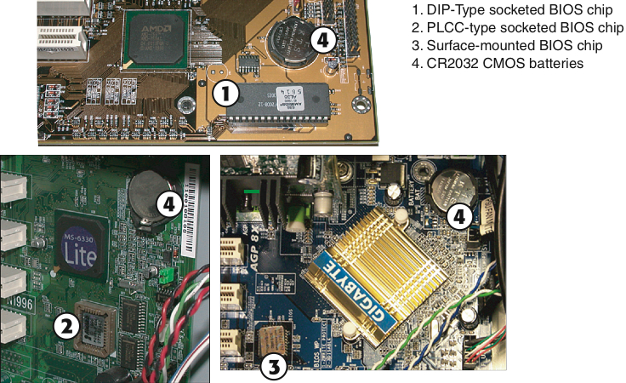
BIOS Locations (Look for Battery)

Slide 8
What Is CMOS?
CMOS = Complementary Metal Oxide Semiconductor
A type of Random Access Memory (RAM).
Memory can be lost without a power source.
On-board battery keeps this functional.
CMOS stores settings used by BIOS:
Boot sequence; hard drive parameters.
BIOS/CMOS access password.
These options are passed to the BIOS soon after the power is turned on.
Settings can be changed by using the CMOS editor.

Slide 9
The Startup BIOS Controls the Beginning of the Boot
Contained on motherboard firmware chip
Successful boot
Hardware, BIOS, operating system all perform without errors (beeps, text or voice messages)
Boot functions
Startup BIOS runs POST and assigns system resources
Startup BIOS program searches for and loads an OS
OS configures system and completes its own loading
Application software is loaded and executed

Slide 10
Step 1: Post and Assignment of System Resources
Turn on PC power
Processor begins the boot by initializing itself
Turns to startup BIOS for instructions
Startup BIOS first performs POST
17 key steps involved

Slide 11
Step 2: Startup Bios Finds and Loads the OS
Startup BIOS looks to CMOS RAM to find boot device
Figure 5-35 For a successful boot, a hard drive must contain a healthy Master Boot Record (MBR) and a healthy OS boot record
Courtesy: Course Technology/Cengage Learning

Slide 12
Step 2: Startup Bios Finds and Loads the OS (cont’d.)
Tracks: concentric circles on drive
Sectors (segments): portion of a track
Holds up to 512 bytes of data
Master Boot Record (MBR)
Contains master boot program and partition table
OS boot record
512-byte sector
Second sector on drive behind MBR
Contains small program pointing to a larger OS program file (BootMgr or Ntldr)

Slide 13
Figure 5-36 Numbered steps show how BIOS searches for and begins to load an operating system (in this example, Windows Vista is the OS)
Courtesy: Course Technology/Cengage Learning

Slide 14
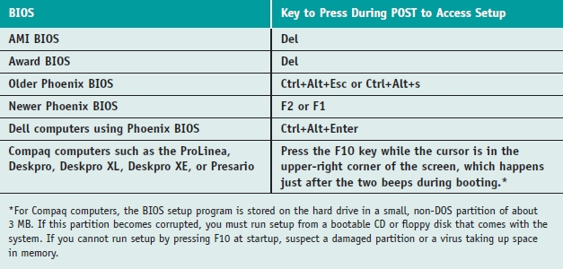
Configuring the Motherboard Using BIOS Setup
Access BIOS setup program
Setup screen appears with menus and Help features
Change system features
Table 5-9 How to access BIOS setup

Slide 15
Figure 5-59 BIOS Setup Main menu
Courtesy: Course Technology/Cengage Learning

Slide 16
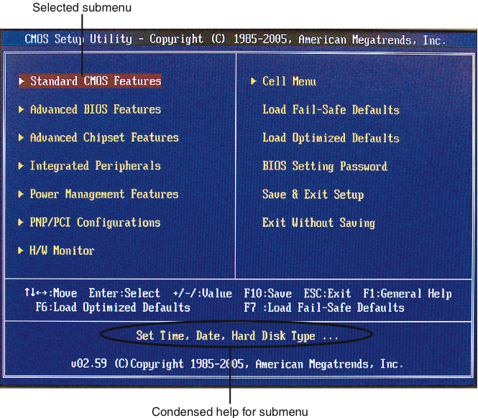
Sample CMOS Editor
Notes:
Be very careful about allowing students to enter the CMOS setup utility screens. This is not to say that they should not; in fact, they should, but you want to make sure that they do not change things that they are not familiar with, which in this type of class, will be most everything. If you have access to an LCD projector, being able to show them how a change would be made can be very useful, while also removing the mystery of how to make such changes. In reality, there are very few changes that need to be made in most modern PCs. Being familiar with the BIOS settings in Table 4-3 will be a very good way to get past most A+ exam questions on BIOS settings.

Slide 17
Configuring the Motherboard Using BIOS Setup (cont’d.)
Change boot menu in BIOS setup
Set boot sequence
Startup password allows access to computer
Enabled and set in BIOS setup
Password stored in CMOS RAM
Changed by accessing setup screen
Exit screen options
Save or discard changes and exit program
Restore default settings
Save changes and remain in program

Slide 18
Configuring the Motherboard Using BIOS Setup (cont’d.)
Brand-name computer manufacturers
Use their own custom-designed setup screens
CMOS RAM setting is lost if battery goes bad or disconnected
Restore default settings
Restore customized settings from written record of all changes
Important to keep records up to date, stored with the hardware documentation in a safe place, well labeled

Slide 19
How to install Windows
Plan the installation.
Chose the windows operating system
There are more windows version
Check for the system requirement for the OS

Slide 20
Choose the Method of Installation
Installation choices
Boot media
Network installation
Hard drive image
Recovery CDs and DVDS
Factory recovery partitions
Repairs to existing installation
Virtual Machine.

Slide 21
virtual computer
Installation in a virtual computer
Virtual computer or virtual machine
Software simulating hardware of a physical computer
Allows installation and running of multiple operating systems at the same time on a PC
Reason to use a virtual machine
Train users, run legacy software, and support multiple operating systems
Can capture screen shots of boot process in a virtual machine

Slide 22
Choose the Type of Installation: Upgrade, Clean Install, or Dual Boot
Installing Windows on a new hard drive
Perform a clean install
Windows already installed on hard drive
Clean install
Overwrite existing operating system and applications
Upgrade (if allowed)
Upgrade Windows 7 to 8
Upgrade Windows 7 to Windows 10
Dual boot
Install Windows 7/Windows 8 in a second partition

Slide 23
Performing a Clean Install or Dual Boot
Steps
1. Boot directly from Windows Vista CD/DVD/USB or ISO image fro a virtual Machine.
Click Install now
2. Enter product key and accept license agreement
3. Choose Custom (advanced) for type of installation
4. List of partitions displayed
Make selection and click Next
5. Drive options (advanced)
Click New, enter size of partition, click Apply
Installation continues

Slide 24
Performing a Clean Install or Dual Boot
Enter user name, password, computer name, date, time, update preference
User name is assigned administrative permissions
Setup checks computer performance
Logon screen appears

Slide 25
What to Do After the Vista Installation
Verify network access
Activate Windows
Install Windows updates and service packs
Configure automatic updates
Configure Vista components
Install hardware
Install applications

Slide 26
Hands On Activities.
Inspecting the BIOS
Installing Windows 7.

Slide 27
Assignment and Lab
Short Answer: Answer questions on BIOS.
Lab: Complete the lab titled “Understanding BIOS and POST.”

